Slide 1
Real Time E-Commerce VoiceBot
Anupam Baksi

Slide 2
Agenda
01
02
03
The Problem - Why voice support matters in e-commerce
Solution - Real-time voice assistant approach
Architecture Overview - System design and components
04
05
06
Technical Stack - Technologies and tools used
Key Engineering Challenges - Problems solved and solutions
Live Demo Scenarios and Screens
07
08
09
Results & Metrics - Performance and outcomes
Key Learnings - Insights from implementation
Future Enhancements - Next steps and improvements

Slide 3
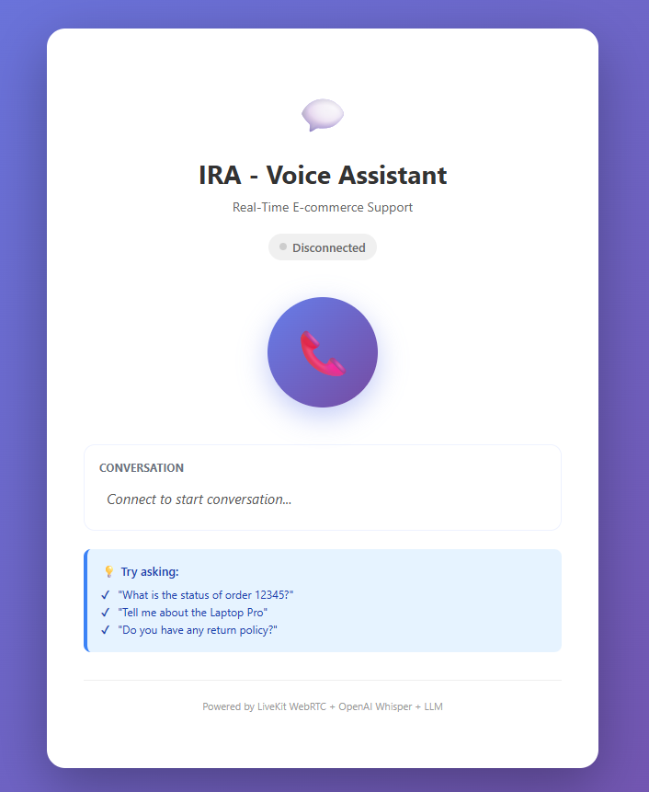
Real Time E-Commerce VoiceBot
A voice-first AI assistant that delivers real-time conversational support for e-commerce platforms, bringing voice support to online shopping through natural, human-like interaction.
A voicebot is an AI system that understands and responds to spoken language, making support feel faster and more intuitive than traditional chat or email. In e-commerce, that matters because customers increasingly expect quick, natural help when they have questions about products, orders, shipping, or returns.
This project solves the common frustration of slow, scripted support by enabling real-time, streaming conversations instead of the usual record-and-upload workflow. Built as a capstone project, it explores how voice AI can make online shopping support feel more immediate, accessible, and human.

Slide 4
The Problem
For e-commerce businesses, these problems have real consequences: lost customers, lower satisfaction, and higher support costs. A real-time voice assistant helps reduce friction and makes support feel immediate, conversational, and more human.
Slow Support Experience
Customer Preference
Old Voice Bots
Customers have to type their questions, click through menus, and wait for responses, which takes time and makes support feel clunky and impersonal. That friction adds up quickly: customers get frustrated, support agents get overwhelmed, and simple issues take longer to resolve than they should.
71% of customers prefer voice for complex support interactions because it is faster, more natural, and easier to use than typing. It is also hands-free, which makes it more convenient in busy moments, and it improves accessibility for users who may struggle with text-based support.
Traditional voice systems often rely on HTTP file uploads, which means the audio has to be recorded, sent, processed, and returned before the conversation can continue. That creates high latency, prevents real-time interaction, and leads to a poor user experience that feels delayed and unnatural.

Slide 5

Solution – A Voice-First Experience
A real-time voice assistant that captures your voice, understands what you say, thinks of an answer, and speaks back to you in just a few seconds.
What makes it different: instead of recording and uploading audio files, the assistant uses real-time WebRTC streaming so voice is processed live with much lower latency and a more natural conversation flow.
How it works end to end: user speaks → the system listens and understands → the AI generates a response → the system speaks back, typically completing the full interaction in 2–4 seconds.
Key capabilities: it can handle order tracking, product questions, and policy inquiries, with RAG lookup used to ground answers in relevant product and support information.
Technical advantage: a hybrid LLM approach using OpenAI or Ollama helps ensure the assistant stays available and reliable, even if one model path is unavailable.
Talk naturally instead of typing
Get quick, spoken answers
Have a smoother support experience
Use voice for more complex questions

Slide 6






Architecture Overview
User's Browser
LiveKit SDK captures audio
Dual LLM Logic:
The system uses OpenAI and Ollama both based
on availability (retries) when an API key is set.
Rule-based responses are used only as a last resort.
LiveKit Worker
VAD + STT processing
LLM Processing
OpenAI (cloud), Ollama (local) , rule-based last resort
Why both?
OpenAI provides high accuracy and broad language support, while Ollama enables local execution, privacy, and lower cost. This setup keeps the assistant reliable with a clear fallback path.
TTS Generation
edge-tts synthesis
Audio Playback
Browser speaker output

Slide 7
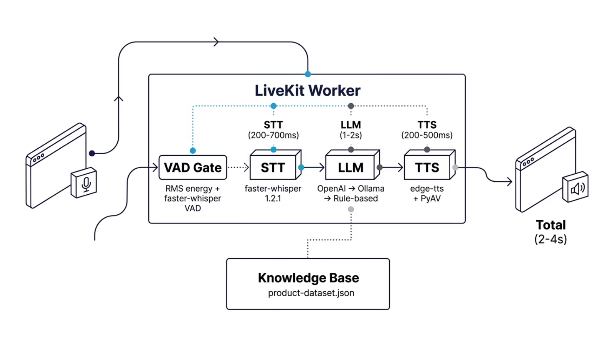
System Architecture & Data Flow
The diagram below illustrates how audio flows through each processing stage, from capture to response. Each component is optimized for speed, with the entire pipeline completing in 2-4 seconds on standard CPU hardware.
This architecture ensures a seamless, real-time conversational experience by leveraging advanced speech processing, intelligent language models, and efficient audio streaming, all while maintaining low latency.

Slide 8
Technical Stack
Layer
Technology
Key Benefit
Audio Transport
LiveKit (WebRTC)
Real-time bidirectional streaming
Speech-to-Text
faster-whisper 1.2.1
4× faster than original Whisper, CPU-only
Language Model
Ollama + llama3.2:1b
Local, private, ~1 s inference
LLM Fallback
OpenAI → Ollama → Rule-based
Always responds, even if cloud/offline
Text-to-Speech
edge-tts + PyAV
Microsoft Neural voice, async, in-memory
Backend
FastAPI (Python)
Token server + static file serving
Frontend
Vanilla JS + LiveKit SDK
Browser mic, audio playback, error UI
Knowledge Base
JSON dataset + keyword RAG
Order/product/policy lookups

Slide 9
Key Engineering Challenges
1
2
Latency
STT Noise
Problem: Voice generation was slow because the system saved audio to temporary files on disk.
Problem: The system picked up background noise and tried to transcribe it as speech.
Impact: Users had to wait 1-2 seconds longer for responses.
Impact: Reduced accuracy and wasted processing time on non-speech audio.
Solution: Switched to generating audio in memory and streaming it directly, cutting wait time by 50-200ms per response.
Solution: Added multiple filters - a noise gate that checks sound energy levels, and a speech detector that only processes actual voice.
3
4
LLM Timeouts
Browser Autoplay
Problem: The AI model took longer to think than the system allowed, causing responses to fail.
Problem: Web browsers block audio playback until the user clicks something (security feature).
Impact: Users got error messages instead of answers.
Impact: Bot couldn't speak on first load.
Solution: Increased the thinking time limit from 12 seconds to 15 seconds, matching how long the AI actually needs.
Solution: Added a click-to-start button that unlocks audio playback for the rest of the session.

Slide 10


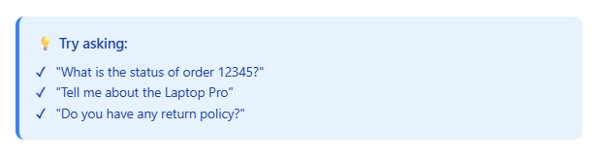

Live Demo Scenarios
Order Tracking
Product Information
"What is the status of order 12345?"
"Tell me about the Laptop Pro."
Bot: "The Laptop Pro features an Intel i9 processor, 32 GB RAM, and 1 TB SSD, priced at $1,499."
Bot: "Order 12345 is Shipped and expected to arrive in 2 days."
(RAG lookup from product-dataset.json)
Policy Questions
"What is your return policy?"
Bot: "You can return any item within 30 days of purchase for a full refund."

Slide 11
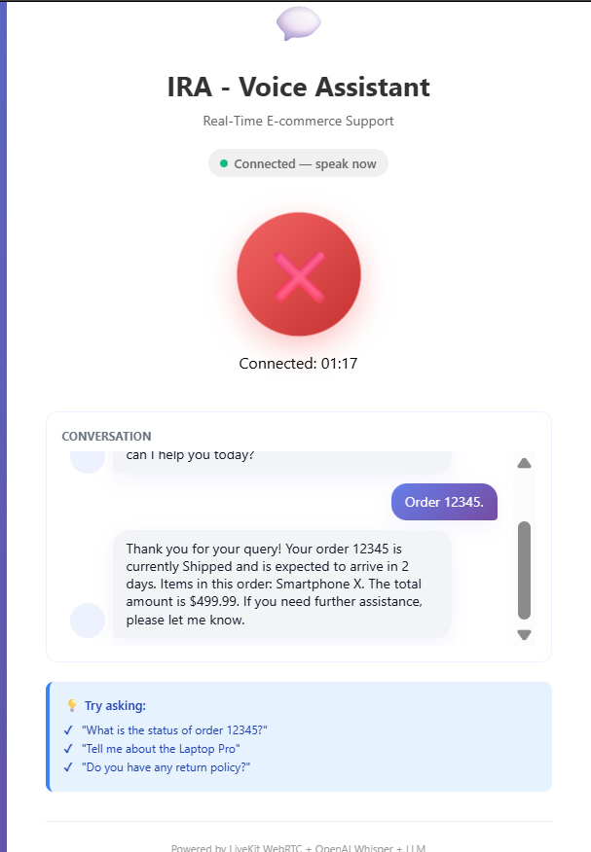
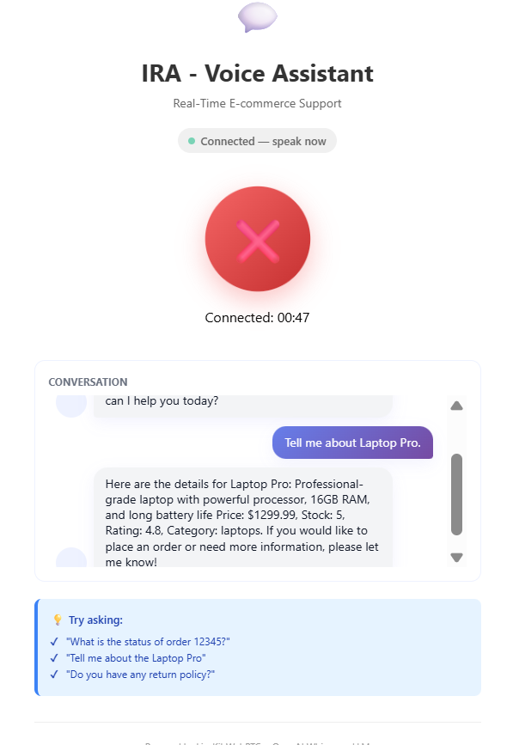
Screens

Slide 12
Results & Metrics
2-4s
~95%
1-2s
Stable
End-to-End Latency
STT Accuracy
LLM Response Time
System Uptime
CPU baseline
Tiny/base hybrid on clear speech
llama3.2:1b inference
During testing
Technology Stack Highlights
Performance Characteristics
faster-whisper 1.2.1 hybrid (tiny/base)
Ollama + llama3.2:1b (local inference)
edge-tts + PyAV (async synthesis)
FastAPI backend with async processing
CPU-only optimization
In-memory processing pipeline
Real-time streaming via WebRTC / LiveKit
Local deployment with async service handling

Slide 13
Key Learnings
01
02
03
Pipeline Timing Had to Be Rebalanced
In-Memory Processing Cut Turn Time
VAD Needed a Tuned Threshold
System stability was maintained only when Ollama stayed under 1.5s and the full turn stayed under 3s; beyond that, noticeable lag and occasional timeouts were observed
Removing temp WAV writes saved roughly 50–200 ms per turn and eliminated file-handling failures during longer test runs
A threshold around 0.45 RMS was found to give the best balance; lower values captured too much background noise, while higher values missed quieter speech
04
05
Async TTS Prevented Audio Stalls
Production Limits Showed Up Under Load
Blocking synthesis calls caused audible pauses and broke conversation flow, while async playback kept the pipeline responsive under repeated turn-taking
Memory usage peaked at about 450MB in sustained testing, so the architecture was kept local and lightweight rather than adding heavier buffering or model layers

Slide 14
Future Enhancements
GPU Inference
Streaming TTS
CUDA acceleration reduces STT from 400 ms to 50 ms, achieving ~1 second total latency
Incremental audio generation eliminates the wait for full response synthesis
Vector RAG
Barge-In Capability
Semantic search with chromadb/pgvector for large product catalogs
User interruption detection for more natural turn-taking
Kubernetes Deployment
Multi-Language Support
GPU auto-scaling and production monitoring for operational readiness
Swap voice and model per locale for localized user experiences
Strategic Recommendation
Strengths
Next Steps
Proven real-time capability
Hybrid LLM architecture
Zero variable costs
Privacy-first design
CPU-only fallback
Limited user pilot (50-100 beta users)
Implement vector RAG integration
Add robust error handling
Load testing under concurrent users

Slide 15
Thank You!

Slide 16
Questions ?

